Slide 1


Starting Out with Python
Sixth Edition
Chapter 10
Classes and Object-Oriented Programming
Copyright © 2023, 2021, 2018 Pearson Education, Inc. All Rights Reserved
Notes:
If this PowerPoint presentation contains mathematical equations, you may need to check that your computer has the following installed:
1) MathType Plugin
2) Math Player (free versions available)
3) NVDA Reader (free versions available)

Slide 2
Topics
Procedural and Object-Oriented Programming
Classes
Working with Instances
Techniques for Designing Classes

Slide 3
Procedural Programming
Procedural programming: writing programs made of functions that perform specific tasks
Procedures typically operate on data items that are separate from the procedures
Data items commonly passed from one procedure to another
Focus: to create procedures that operate on the program’s data

Slide 4
Object-Oriented Programming (1 of 4)
Object-oriented programming: focused on creating objects
Object: entity that contains data and procedures
Data is known as data attributes and procedures are known as methods
Methods perform operations on the data attributes
Encapsulation: combining data and code into a single object

Slide 5
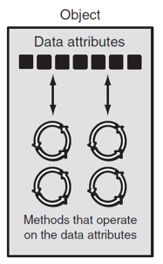
Object-Oriented Programming (2 of 4)
Figure 10-1 An object contains data attributes and methods
Notes:
An object contains data attributes and methods that operate on the data attributes. The data attributes is depicted as small squares and the methods are depicted as circular loops, within the object. Double headed arrows indicate the interaction between the data attributes and the methods.

Slide 6
Object-Oriented Programming (3 of 4)
Data hiding: object’s data attributes are hidden from code outside the object
Access restricted to the object’s methods
Protects from accidental corruption
Outside code does not need to know internal structure of the object
Object reusability: the same object can be used in different programs
Example: 3D image object can be used for architecture and game programming

Slide 7
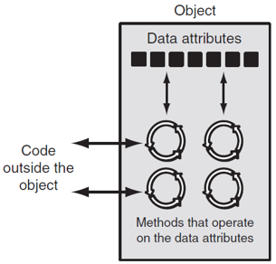
Object-Oriented Programming (4 of 4)
Figure 10-2 Code outside the object interacts with the object's methods
Notes:
An object contains data attributes and methods that operate on the data attributes. The data attributes is depicted as small squares and the methods are depicted as circular loops, within the object. Double headed arrows indicate the interaction between the data attributes and the methods. The interaction between the code outside the object and the methods is also depicted by double headed arrows.

Slide 8
An Everyday Example of an Object
Data attributes: define the state of an object
Example: clock object would have second, minute, and hour data attributes
Public methods: allow external code to manipulate the object
Example: set_time, set_alarm_time
Private methods: used for object’s inner workings

Slide 9
Classes (1 of 3)
Class: code that specifies the data attributes and methods of a particular type of object
Similar to a blueprint of a house or a cookie cutter
Instance: an object created from a class
Similar to a specific house built according to the blueprint or a specific cookie
There can be many instances of one class

Slide 10
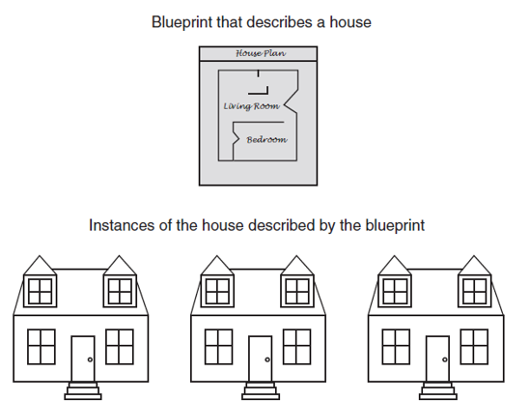
Classes (2 of 3)
Figure 10-3 A blueprint and houses built from the blueprint

Slide 11
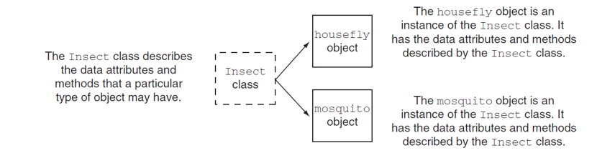
Classes (3 of 3)
Figure 10-5 The housefly and mosquito objects are instances of the Insect class
Notes:
The following notes are present beside the insect class and the housefly and mosquito objects. The Insect class describes the data attributes and methods that a particular type of object may have. The housefly object is an instance of the Insect class. It has the data attributes and methods described by the Insect class. The mosquito object is an instance of the Insect class. It has the data attributes and methods described by the Insect class.

Slide 12
Class Definitions (1 of 7)
Class definition: set of statements that define a class’s methods and data attributes
Format: begin with class Class_name:
Class names often start with uppercase letter
Method definition like any other python function definition
self parameter: required in every method in the class – references the specific object that the method is working on

Slide 13
Class Definitions (2 of 7)
Initializer method: automatically executed when an instance of the class is created
Initializes object’s data attributes and assigns self parameter to the object that was just created
Format: def __init__ (self):
Usually the first method in a class definition

Slide 14
Class Definitions (3 of 7)
import random
class Coin:
def __init__(self):
self.sideup = 'Heads'
def toss(self):
if random.randint(0, 1) == 0:
self.sideup = 'Heads'
else:
self.sideup = 'Tails'
def get_sideup(self):
return self.sideup

Slide 15
Class Definitions (4 of 7)
To create a new instance of a class
Format: variable_name = ClassName()
Example:
my_coin = Coin()
This creates an instance of the class and calls the class's __init__ method

Slide 16
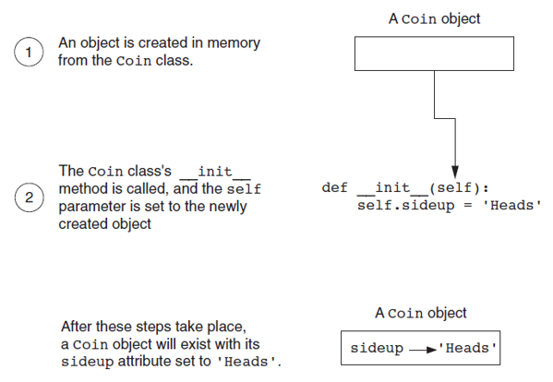
Class Definitions (5 of 7)
Figure 10-6 Actions caused by the coin() expression
Notes:
The steps in the illustration are as follows. Step 1. An object is created in memory from the Coin class. A Coin object that is represented by an empty rectangle points to the pseudo code in the second step. Step 2. The Coin class’s underscore underscore i n i t underscore underscore method is called, and the self parameter is set to the newly created object. The adjoining pseudo code is as follows. Line 1. d e f underscore underscore i n i t underscore underscore left parenthesis self right parenthesis colon. Line 2, indented once. self period side up = open quote Heads close quote. Step 3. After these steps take place, a Coin object will exist with its sideup attribute set to open quote Heads close quote. The empty rectangle of the coin object now contains an arrow that points from side up to open quote Heads close quote.

Slide 17
Class Definitions (6 of 7)
To call any of the class methods using the created instance, use dot notation
Format: My_instance.method()
Because the self parameter references the specific instance of the object, the method will affect this instance
Reference to self is passed automatically

Slide 18
Class Definitions (7 of 7)
1 | my_coin = Coin()
2 | my_coin.toss()
3 | print(my_coin.get_sideup())
Line 1: | Creates an instance of the Coin class and executes the __init__ method. A reference to the object is assigned to the my_coin variable.
Line 2: | Calls the my_coin object's toss method.
Line 3: | Calls the the my_coin object's get_sideup method and displays the value it returns.

Slide 19
Hiding Attributes and Storing Classes in Modules
An object’s data attributes should be private
To make sure of this, place two underscores (__) in front of attribute name
Example: __sideup
Classes can be stored in modules
Filename for module must end in .py
Module can be imported to programs that use the class

Slide 20
The BankAccount Class – More About Classes
Class methods can have multiple parameters in addition to self
For __init__, parameters needed to create an instance of the class
Example: a BankAccount object is created with a balance
When called, the initializer method receives a value to be assigned to a __balance attribute
For other methods, parameters needed to perform required task
Example: deposit method amount to be deposited

Slide 21
The __str__ method
Object’s state: the values of the object’s attribute at a given moment
__str__ method: displays the object’s state
Automatically called when the object is passed as an argument to the print function
Automatically called when the object is passed as an argument to the str function

Slide 22
Working With Instances
Instance attribute: belongs to a specific instance of a class
Created when a method uses the self parameter to create an attribute
If many instances of a class are created, each would have its own set of attributes

Slide 23
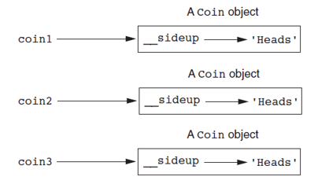
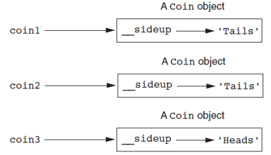
Three Coin Objects
Figure 10-8 The coin1 , coin2, and coin3 variables reference three coin objects
Figure 10-9 The objects after the toss method
Notes:
coin 1 points to a coin object, in which underscore underscore side up points to open quote Heads close quote. coin 2 points to a coin object, in which underscore underscore side up points to open quote Heads close quote. coin 3 points to a coin object, in which underscore underscore side up points to open quote Heads close quote.
coin 1 points to a coin object, in which underscore underscore side up points to open quote Tails close quote. coin 2 points to a coin object, in which underscore underscore side up points to open quote Tails close quote. coin 3 points to a coin object, in which underscore underscore side up points to open quote Heads close quote.

Slide 24
Accessor and Mutator Methods
Typically, all of a class’s data attributes are private and provide methods to access and change them
Accessor methods: return a value from a class’s attribute without changing it
Safe way for code outside the class to retrieve the value of attributes
Mutator methods: store or change the value of a data attribute

Slide 25
Passing Objects as Arguments
Methods and functions often need to accept objects as arguments
When you pass an object as an argument, you are actually passing a reference to the object
The receiving method or function has access to the actual object
Methods of the object can be called within the receiving function or method, and data attributes may be changed using mutator methods

Slide 26
Techniques for Designing Classes
U M L diagram: standard diagrams for graphically depicting object-oriented systems
Stands for Unified Modeling Language
General layout: box divided into three sections:
Top section: name of the class
Middle section: list of data attributes
Bottom section: list of class methods

Slide 27
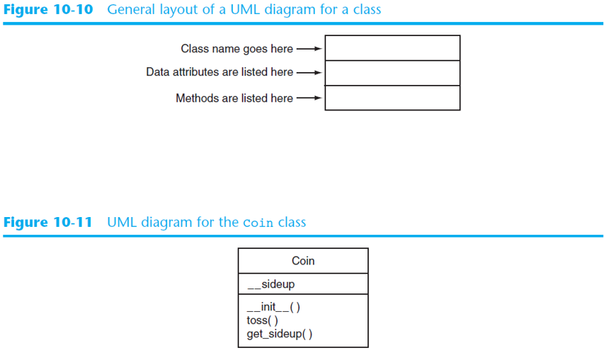
U M L Diagrams
Figure 10-10 General layout of a U M L diagram for a class
Figure 10-11 U M L diagram for the coin class
Notes:
The U M L class diagram is depicted as a table with a single column, without a header, and three rows. The class name, coin, is present in the first row. The attribute listed in the second row is underscore underscore side up. The methods listed in the third row are underscore underscore i n i t underscore underscore left parenthesis right parenthesis, toss left parenthesis right parenthesis, and get underscore side up left parenthesis right parenthesis.

Slide 28
Finding the Classes in a Problem (1 of 4)
When developing object oriented program, first goal is to identify classes
Typically involves identifying the real-world objects that are in the problem
Technique for identifying classes:
Get written description of the problem domain
Identify all nouns in the description, each of which is a potential class
Refine the list to include only classes that are relevant to the problem

Slide 29
Finding the Classes in a Problem (2 of 4)
Get written description of the problem domain
May be written by you or by an expert
Should include any or all of the following:
Physical objects simulated by the program
The role played by a person
The result of a business event
Recordkeeping items

Slide 30
Finding the Classes in a Problem (3 of 4)
Identify all nouns in the description, each of which is a potential class
Should include noun phrases and pronouns
Some nouns may appear twice

Slide 31
Finding the Classes in a Problem (4 of 4)
Refine the list to include only classes that are relevant to the problem
Remove nouns that mean the same thing
Remove nouns that represent items that the program does not need to be concerned with
Remove nouns that represent objects, not classes
Remove nouns that represent simple values that can be assigned to a variable

Slide 32
Identifying a Class’s Responsibilities
A classes responsibilities are:
The things the class is responsible for knowing
Identifying these helps identify the class’s data attributes
The actions the class is responsible for doing
Identifying these helps identify the class’s methods
To find out a class’s responsibilities look at the problem domain
Deduce required information and actions

Slide 33
Summary
This chapter covered:
Procedural vs. object-oriented programming
Classes and instances
Class definitions, including:
The self parameter
Data attributes and methods
__init__ and __str__ functions
Hiding attributes from code outside a class
Storing classes in modules
Designing classes

Slide 34

Copyright
This work is protected by United States copyright laws and is provided solely for the use of instructors in teaching their courses and assessing student learning. Dissemination or sale of any part of this work (including on the World Wide Web) will destroy the integrity of the work and is not permitted. The work and materials from it should never be made available to students except by instructors using the accompanying text in their classes. All recipients of this work are expected to abide by these restrictions and to honor the intended pedagogical purposes and the needs of other instructors who rely on these materials.

